Slide 1
June Dow Meeting
John Bangsund
Kyle Hershey
Robert Newcomb
6/4/18

Slide 2
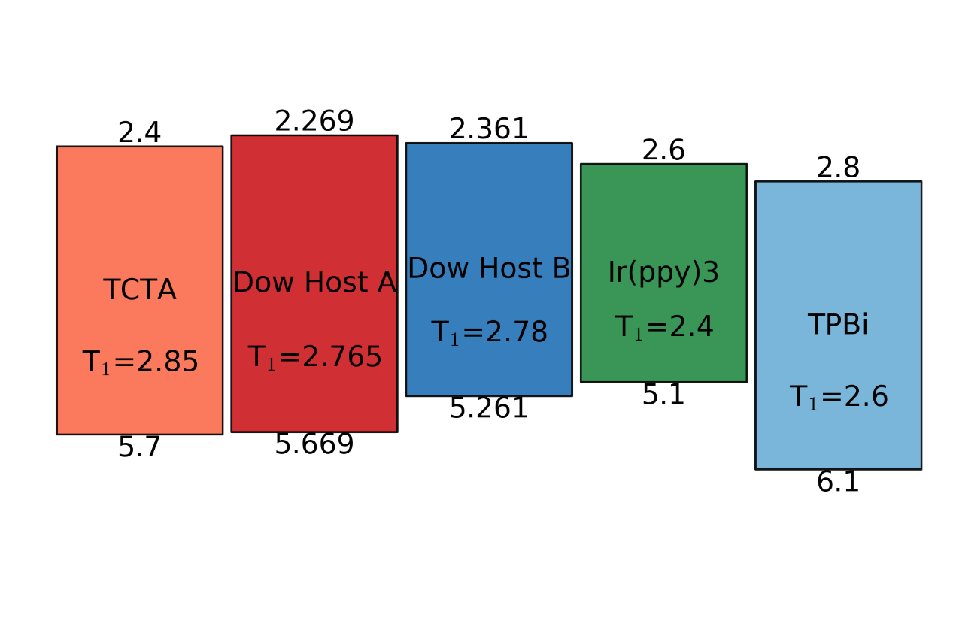
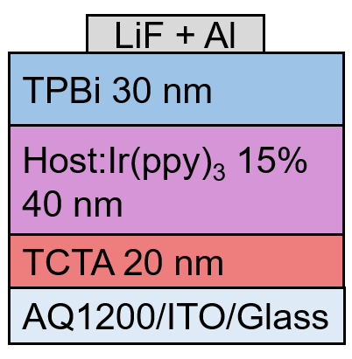
Completing Dow Host Study
Key action items for new supplies of materials to complete study and manuscript
Redo devices at 15% doping, previously efficiency was found to be low
Examine the composition dependence of efficiency in order to assess the role of A or B in transport/injection
Examine the composition dependence of device lifetime to check consistency with current interface degradation hypothesis

Slide 3
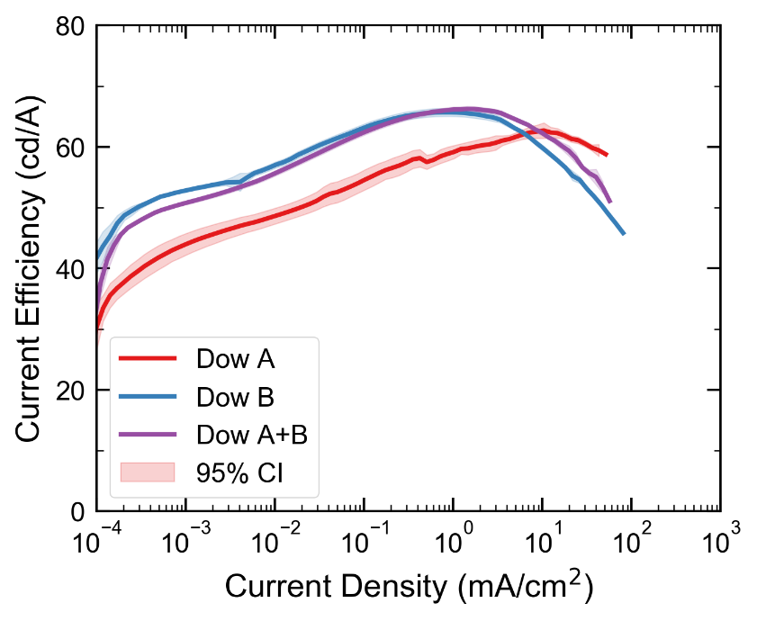
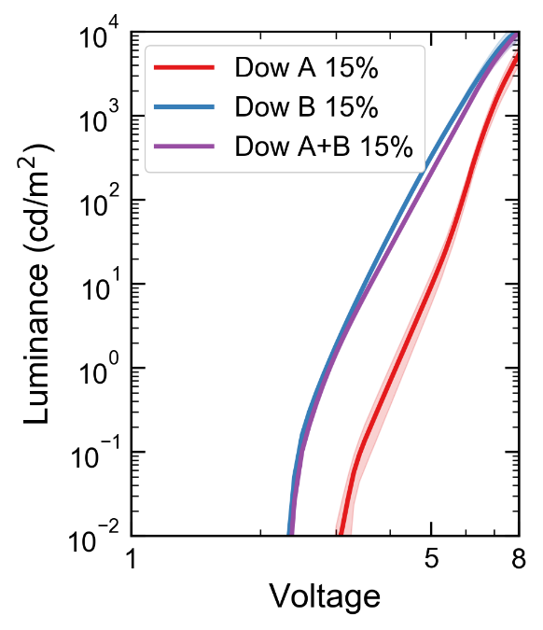
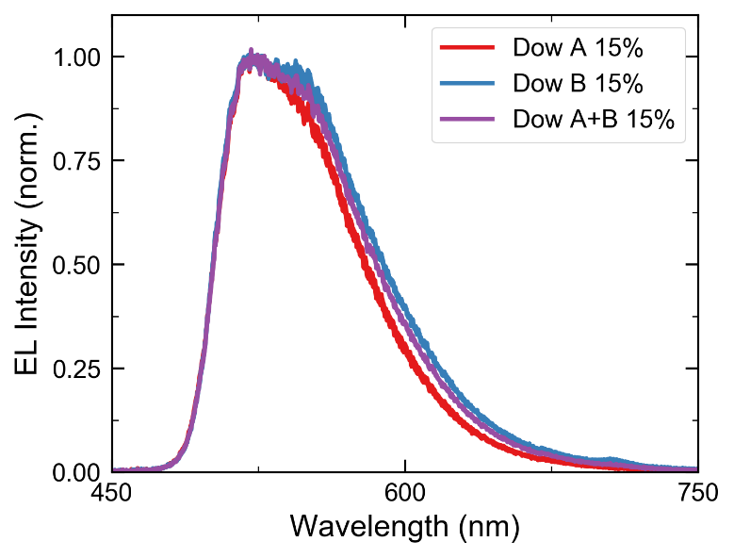
Device Performance with 15% Ir(ppy)₃
High efficiency obtained for all three devices, addition of A leads to a slight decrease in efficiency
Previously, tooling factor was off leading to high Ir(ppy)₃ concentration and low efficiencies
B and A+B have similar efficiency
Roll-off is improved with higher content of A

Slide 4
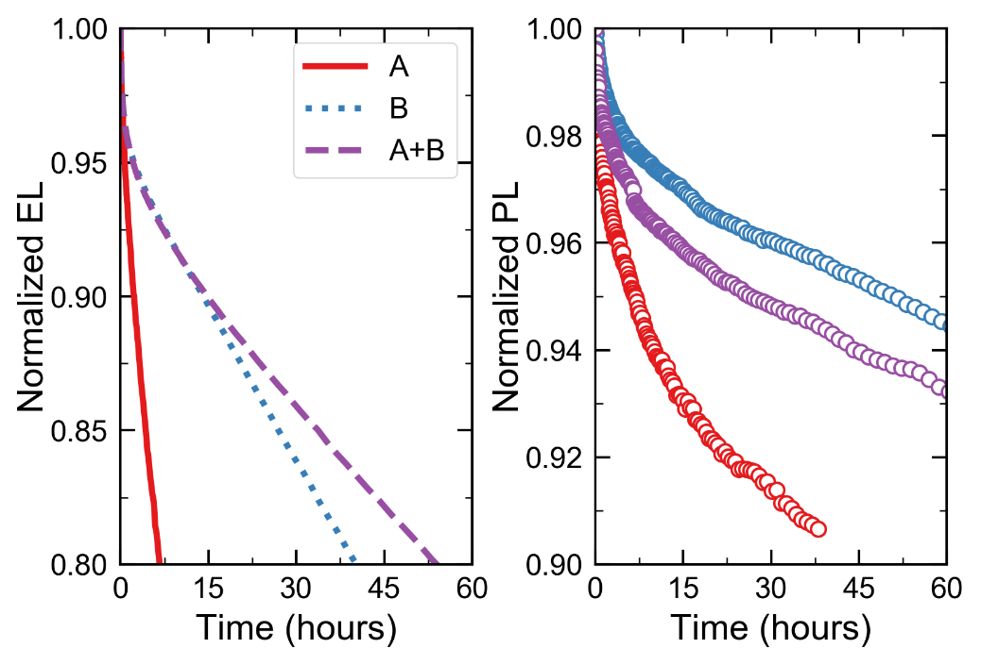
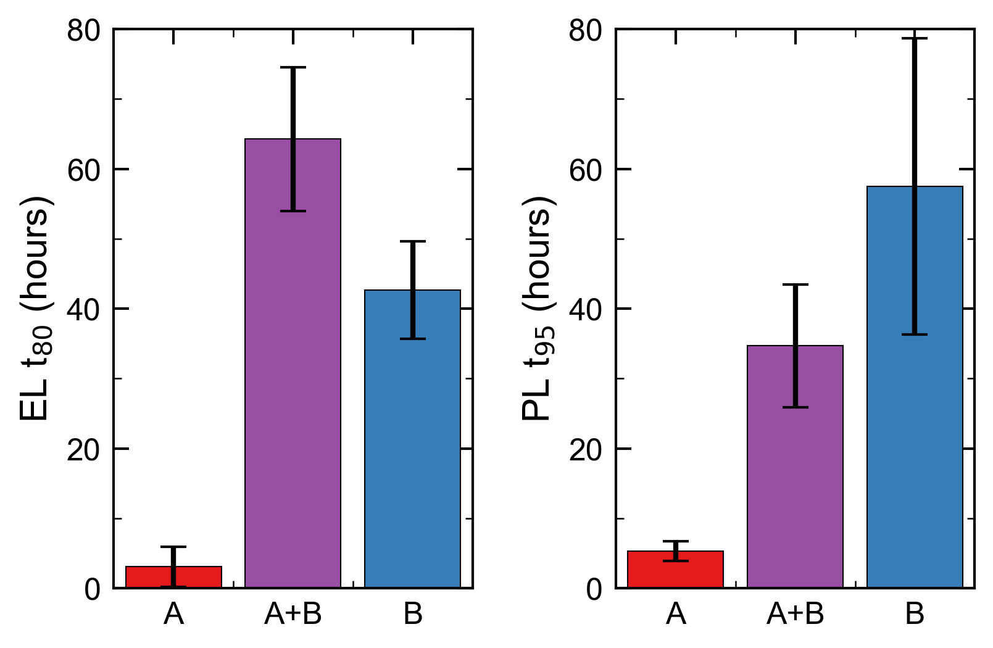
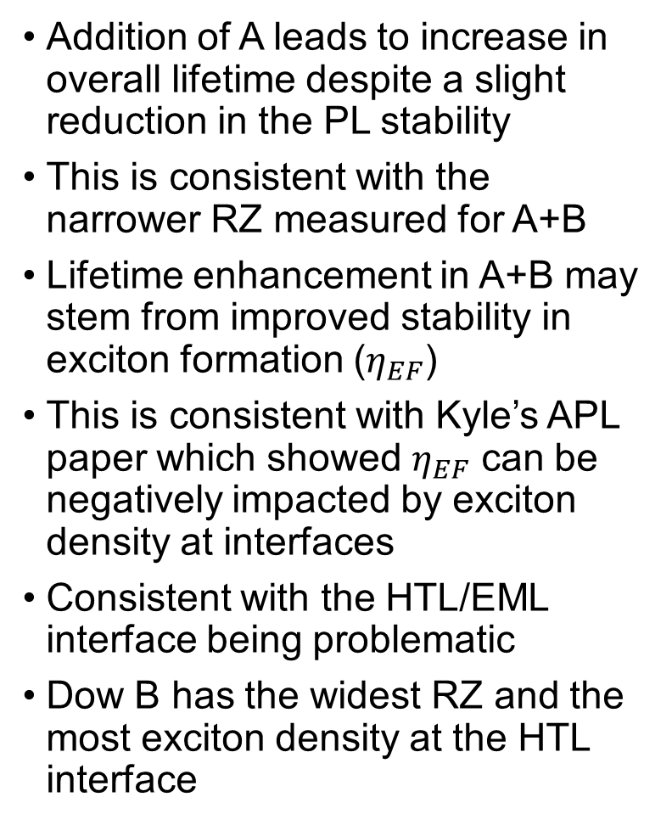
Device Performance with 15% Ir(ppy)₃
Addition of A leads to increase in overall lifetime despite a slight reduction in the PL stability
This is consistent with the narrower RZ measured for A+B
Lifetime enhancement in A+B may stem from improved stability in exciton formation ($η_{EF}$)
This is consistent with Kyle’s APL paper which showed $η_{EF}$ can be negatively impacted by exciton density at interfaces
Consistent with the HTL/EML interface being problematic
Dow B has the widest RZ and the most exciton density at the HTL interface

Slide 5
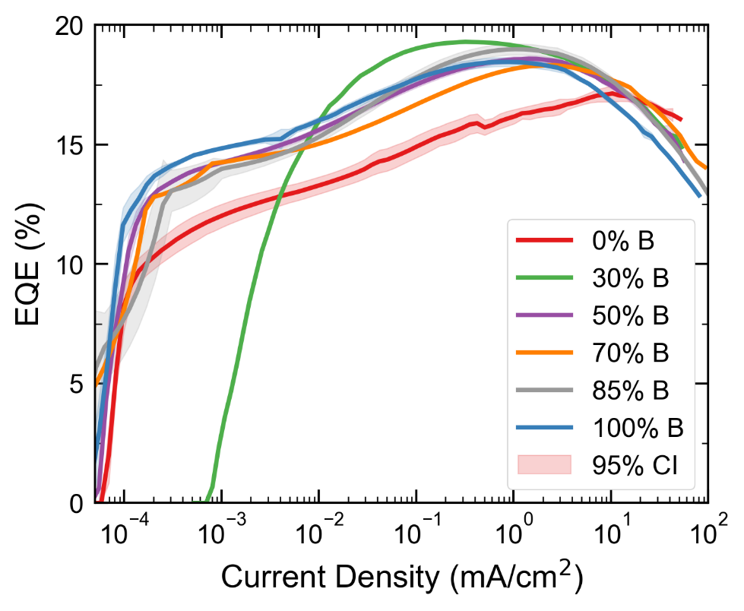
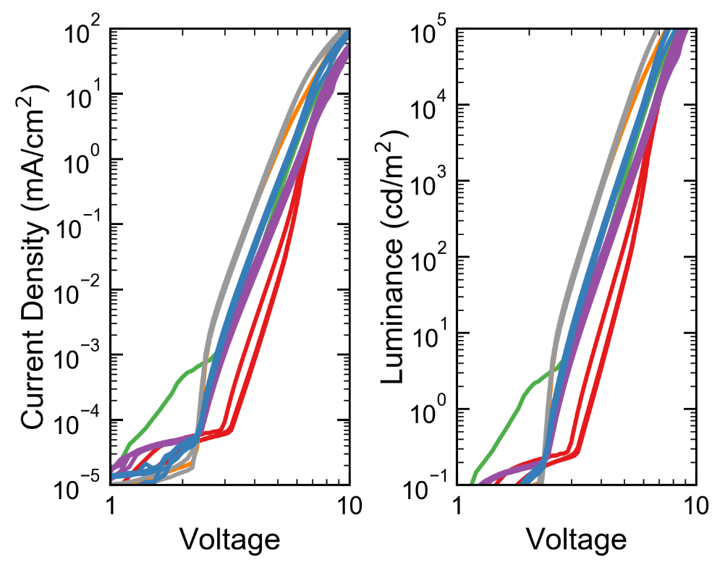
Dependence on EML Composition
Efficiency peak is not strongly sensitive to the amount of B, all devices containing B show similar efficiency
Addition of B to A leads to an immediate reduction in voltage, perhaps suggesting a reduction in electron injection barrier
Addition of A to B does not immediately impact efficiency – supports that A modulates mobility, not injection

Slide 6
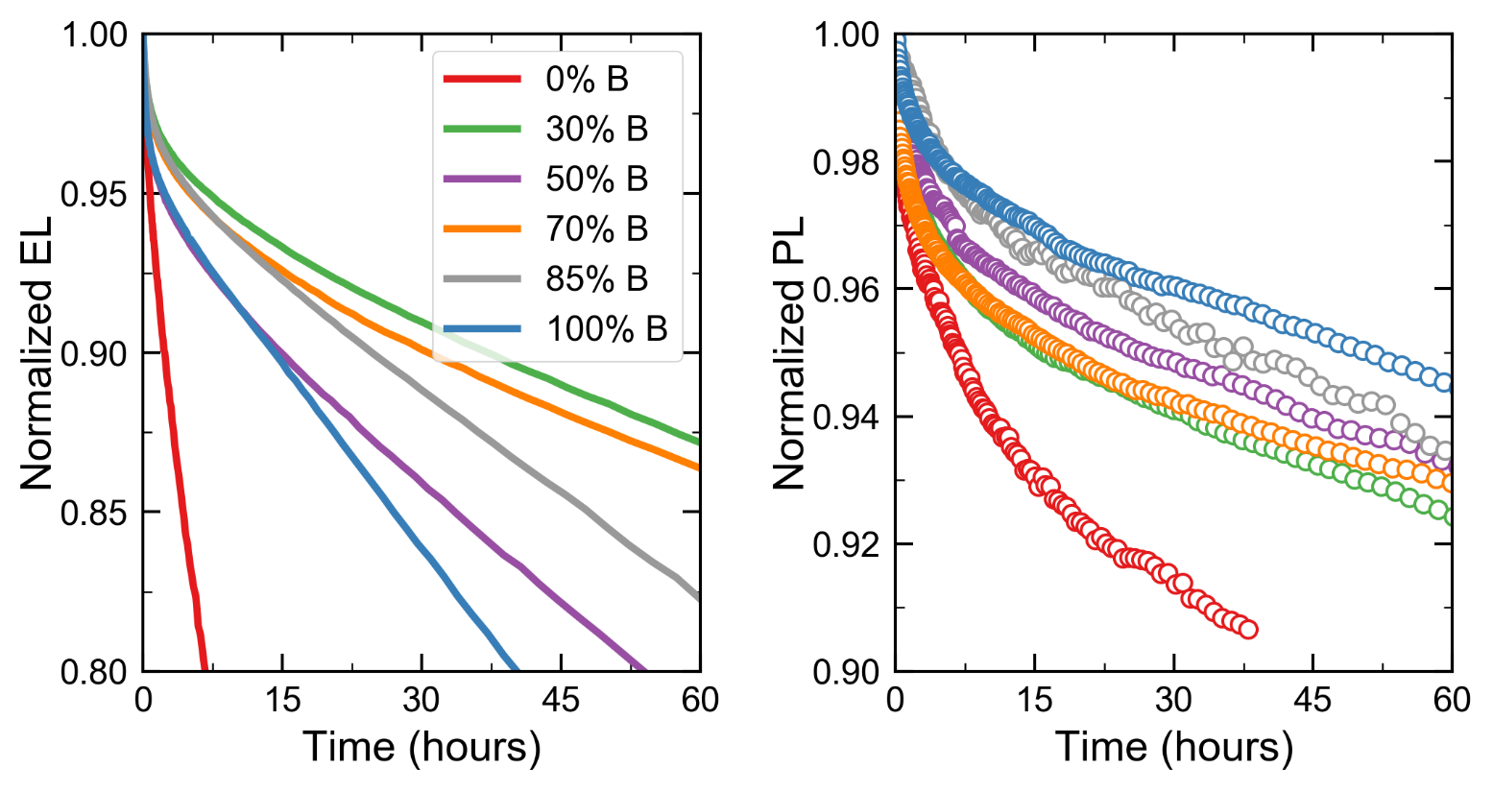
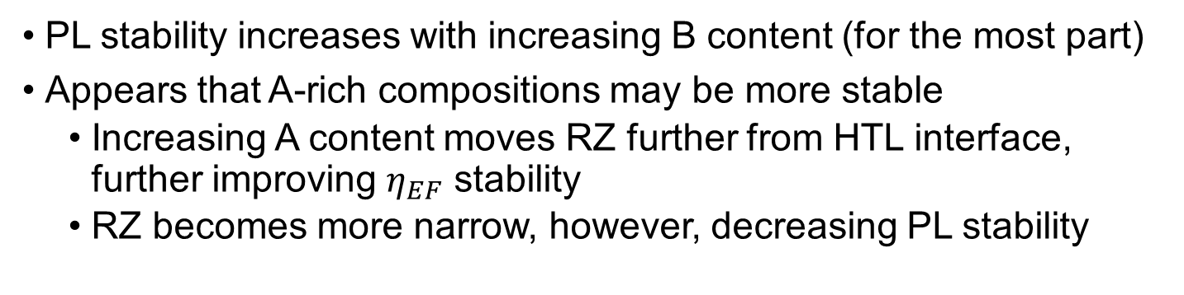
Dependence on EML Composition
PL stability increases with increasing B content (for the most part)
Appears that A-rich compositions may be more stable
Increasing A content moves RZ further from HTL interface, further improving $η_{EF}$ stability
RZ becomes more narrow, however, decreasing PL stability

Slide 7
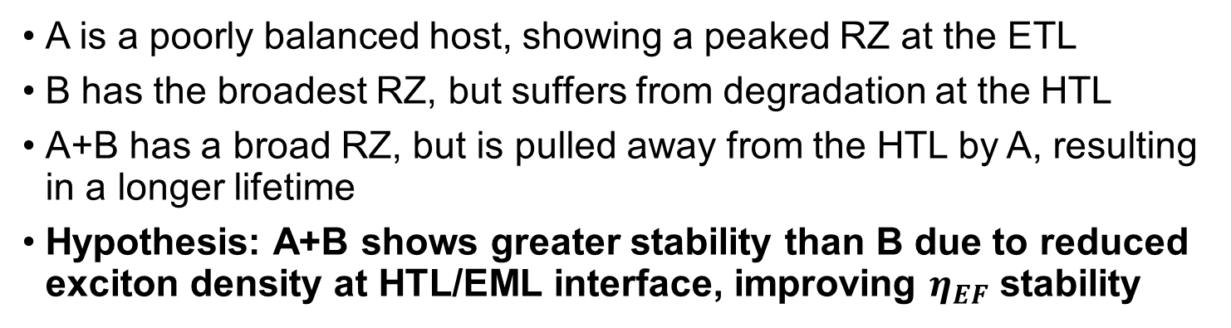
Current Model for Operation
A is a poorly balanced host, showing a peaked RZ at the ETL
B has the broadest RZ, but suffers from degradation at the HTL
A+B has a broad RZ, but is pulled away from the HTL by A, resulting in a longer lifetime
Hypothesis: A+B shows greater stability than B due to reduced exciton density at HTL/EML interface, improving $η_{EF}$ stability
Al
ETL
Differences in efficiency can’t explain lifetime difference because B and A+B show nearly identical efficiency
Hypothesis is further confirmed by 10 nm EML devices where all devices sample the HTL, the same lifetime is seen for B and A+B
EML
HTL
ITO

Slide 8
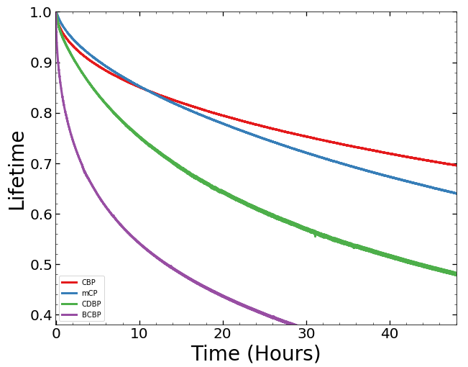
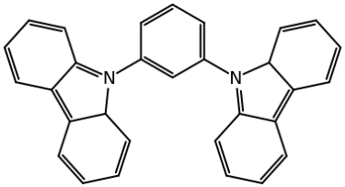
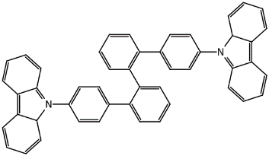
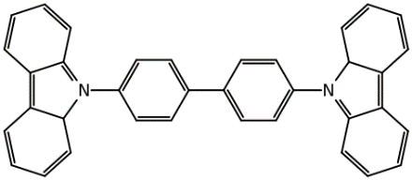
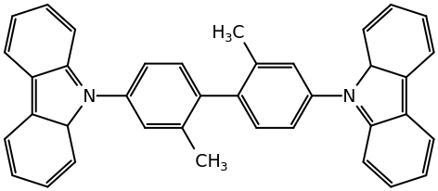
Carbazole Lifetime Comparison
Goal is to develop design rules for host selection – initiated study with a series of carbazole hosts that have been shown to have high efficiency with Ir(ppy)₃
Despite similar efficiencies, there is a clear difference in device lifetime that does not seem to reflect a simple energetic argument or a difference in charge balance
BCBP
EL
mCP
CDBP
CBP

Slide 9
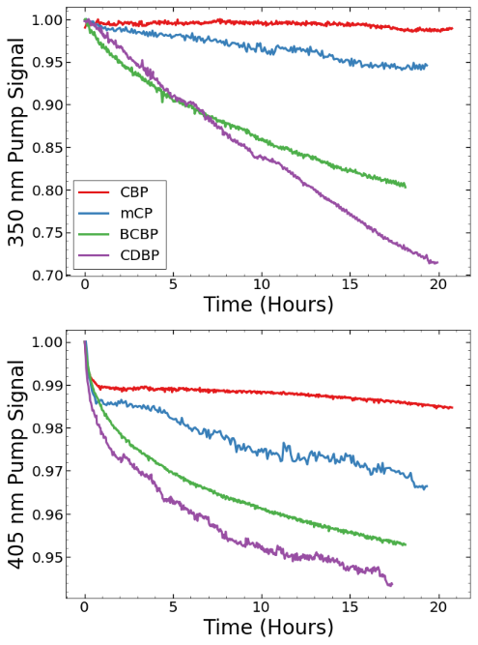
Wavelength Dependent Optical Degradation
350 nm Pump excites host and Ir(ppy)₃
405 nm only excites Ir(ppy)₃
Differences between wavelengths reflect loss in exciton transfer process
Same trend is seen under host optical pumping as is seen in EL
405 nm probe signal shows same trend as 350 nm pump
350 nm
405 nm
350 nm
405 nm
time

Slide 10
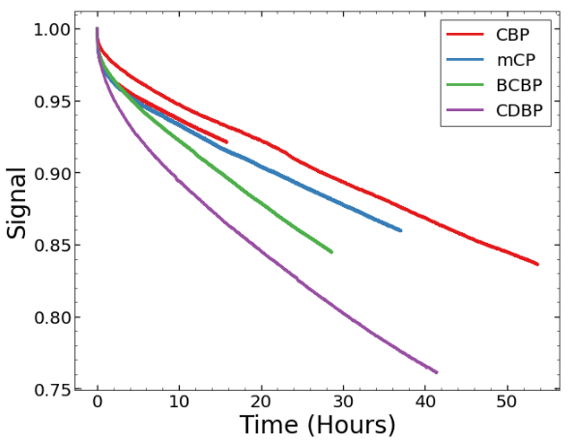
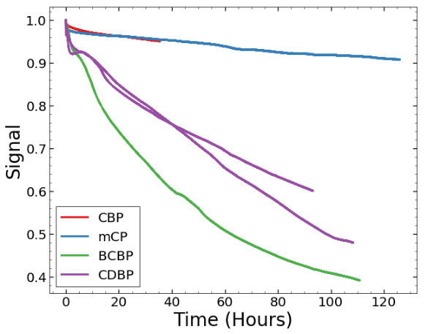
Host Degradation at 405 nm
405 nm 5% doping
405 nm 1% doping
Degrading at 405 nm, same trend seen
Why different if host not absorbing?
Hypothesis: Exciton-exciton events driving degradation
Lowering concentration may reduce TT annihilation
Degradation at 1% doping still shows deviation
CBP and mCP fall together
Perhaps reflects differences in local exciton environment: aggregation or morphology?

Slide 11
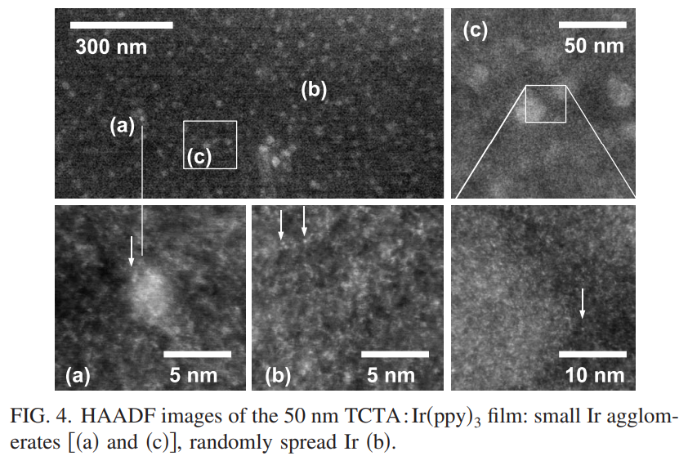
Hypotheses
Ir(ppy)₃ Aggregation
1% degradation suggests CDBP and BCBP degrade more at low concentration
May reflect differences in molecular aggregation
We might observe this in PL efficiency between hosts as a function of concentration
Host excitons being populated
Excited state absorption?
Reineke, Sebastian, et al. "Highly phosphorescent organic mixed films: The effect of aggregation on triplet-triplet annihilation." Applied Physics Letters 94.16 (2009): 116.

